Slide 1

Medical Store-Distributor-Consumer Network
Design and 30% Presentation Template
Abdulla Iqbal FA17-BSE-030
Armaghan Hassan FA17-BSE-045
Majid Durani FA17-BSE-021
Supervisor: Sir Kashif Nasir
Department of Computer Science
COMSATS University Islamabad, Abbottabad Campus

Slide 2
Agenda of the Presentation
Agenda of the presentation is to study the following:
Software Requirement Document
Software Design Document

Slide 3

Brief Introduction
The Medical Store Distributor Consumer Network (MSDCN) is a website which allows the user to maintain their inventory and to sell their stock, which will be used by Medical store and Pharmaceutical Distributors. This website will store details of medicine purchase and selling w.r.t Retailer and Distributor. The website will also consist of Billing generation, Reporting module, Transection and Medicine shortage notification module.

Slide 4
Scope
Our system will target Medicine market.
The problem with current medicine market is that all the communication, transactions, order placing, and order delivery is based on paperwork and wire transfers which results in delays and there is no monitoring.
Our system will provide online platform for both Medical Stores and Pharmaceutical Distributors.
It will allow them to monitor their transaction, online payment module, order details, point of sale details, inventory managements and will generate reports on the basis of profit and loss.
Physical Order Delivery will not be covered by this system.

Slide 5
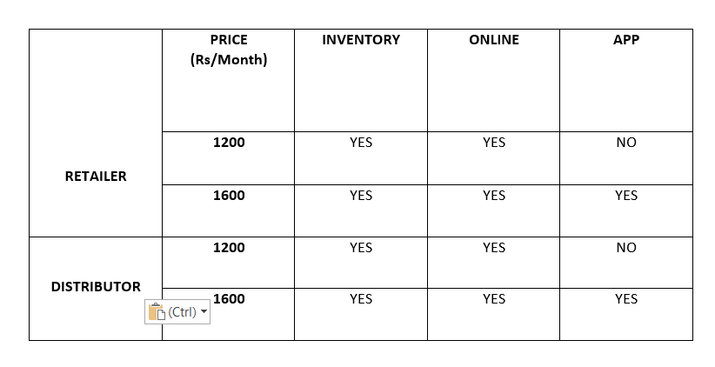
Our Packages

Slide 6
Functional Requirements
FR-1: A new user would be able to get register
FR-2: User cannot login until Admin verifies them(Payment, License).
FR-3: User shall be able to select the desired package.
FR-4: User can register multiple times but Email, License No must be different.
FR-5: User can login by using Email and Password provided while registration.
FR-6: Retailer should be able to buy Medicines online from the Distributor and he can also pay for that order through Credit Card or Cash on Delivery.
FR-7: Retailer shall be able to use the Point of Sale to sell their stock to the Customer.
FR-8: User shall be notified if the product is about to get out of stock.
FR-9: User shall be able to maintain their inventory by adding, deleting and updating the items.
FR-10: User shall manually update the stock in their inventory.
FR-11: When Distributer add the product in the inventory it shall automatically be available to the Retailer at the Online Store.
FR-12: User should be able to generate reports based on Daily, Monthly and Yearly.
FR-13: User should be able to see their transection detail
FR-14: User Should be able to only change the Address, Email, Password, Contact and Credit Card details
FR-15: Medicine Retailer price and Distributor price should be set by themselves.

Slide 7
Non-Functional Requirements
User should be able to learn how to operate the website with in 30 min of training.
Down time of the website should not exceed more than 10 sec for continuous succession of 500 hrs.
Website should be able to handle 100 hits per minute.
Website should be able to work on any browser.
The system development process and deliverable documents shall conform to the ISO STANDARDS
The system shall not disclose any personal information about members of the MSDCN to other members except system administrators.
Credit Card details should be stored in an encrypted form.
Our company is complied with the local and national laws regarding the use of software tools and User privacy.

Slide 8
User Goals
User wants platform through which they can maintain their inventory, perform daily sales, can buy medicines through online means and can maintain all the records.

Slide 9
Use Cases
Registration
Login
Online Shop
Inventory
New Sale (POS)
Generate Reports
Transection Details
User Verification
Add Medicine Information

Slide 10
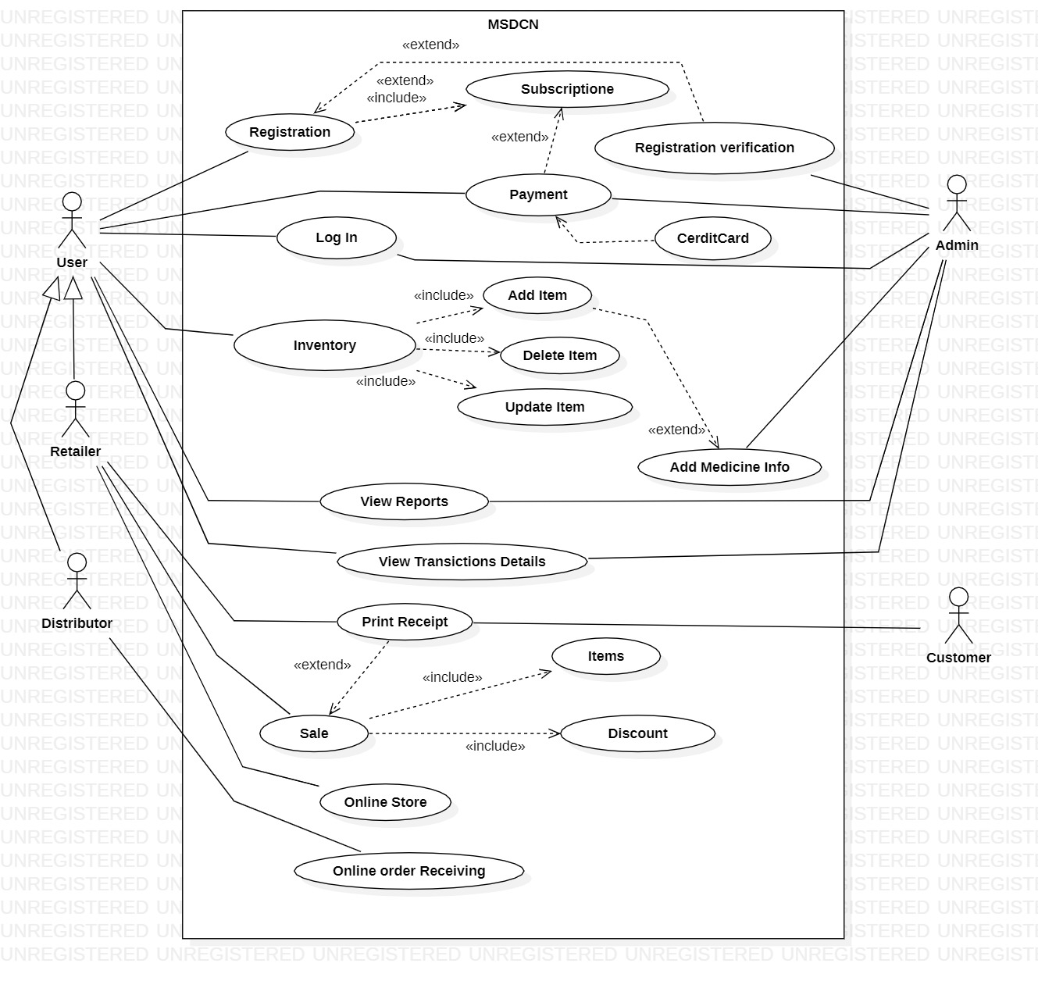
Use Case Diagram
DIRECT STAKEHOLDERS
RETAILER
DISTRIBUTOR
ADMIN
INDIRECT STAKEHOLDERS:
CUSTOMER

Slide 11
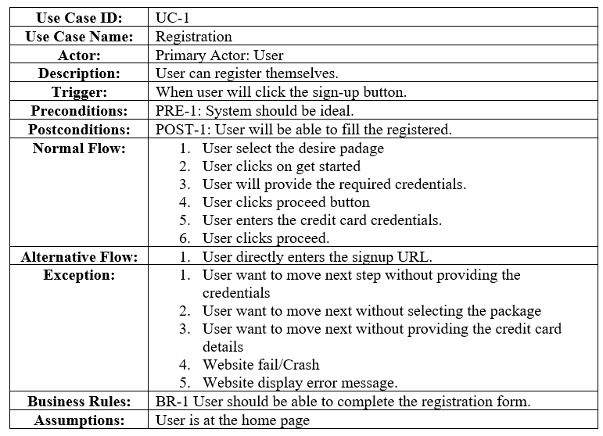
Detailed Use Cases
Registration

Slide 12
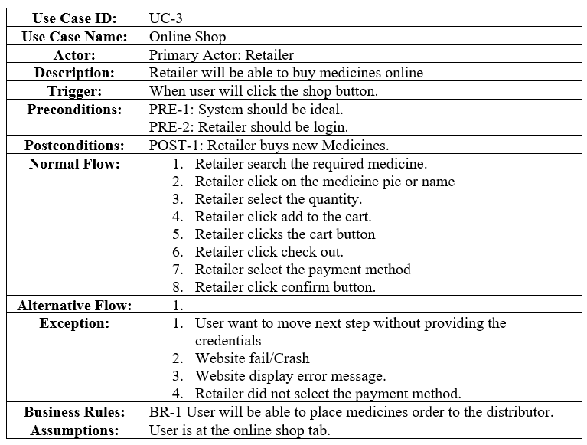
Detailed Use Cases
Online Shop

Slide 13
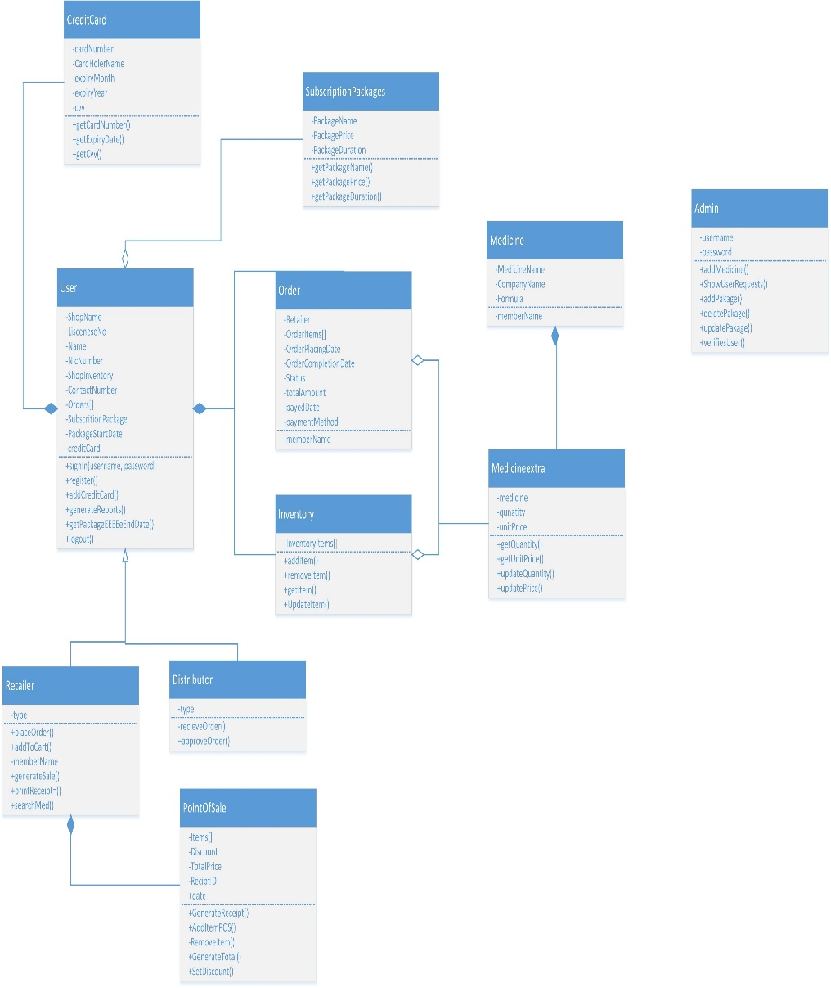
Class Diagram

Slide 14
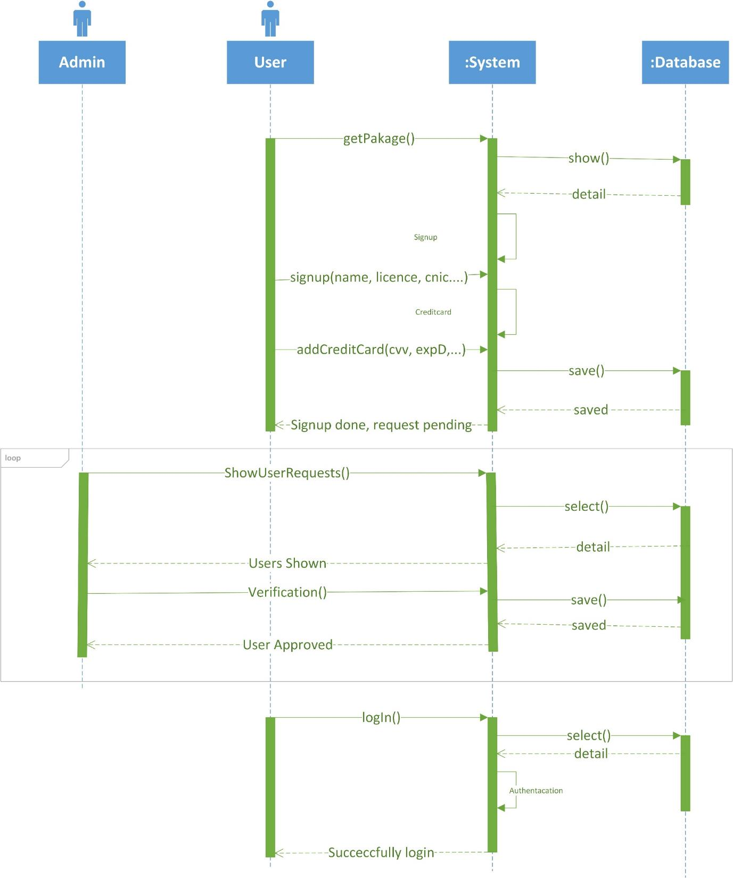
Sequence Diagram
Sign Up
Sign In
Account verification

Slide 15
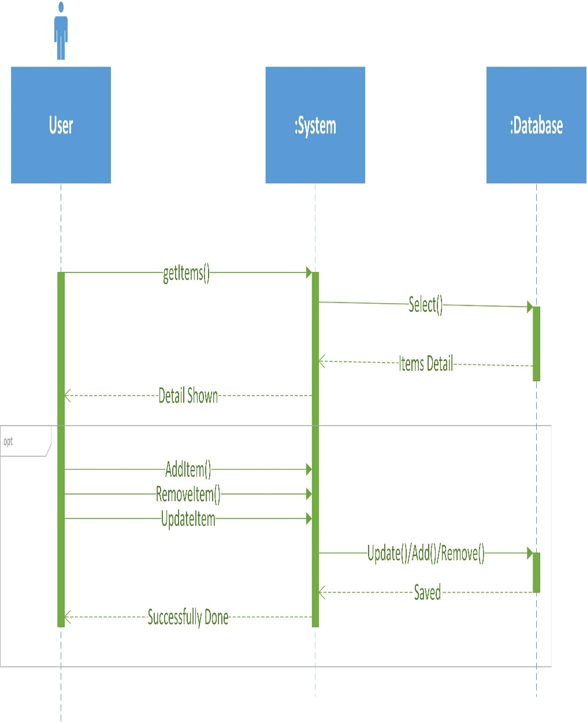
Sequence Diagram
Add Item to Inventory

Slide 16
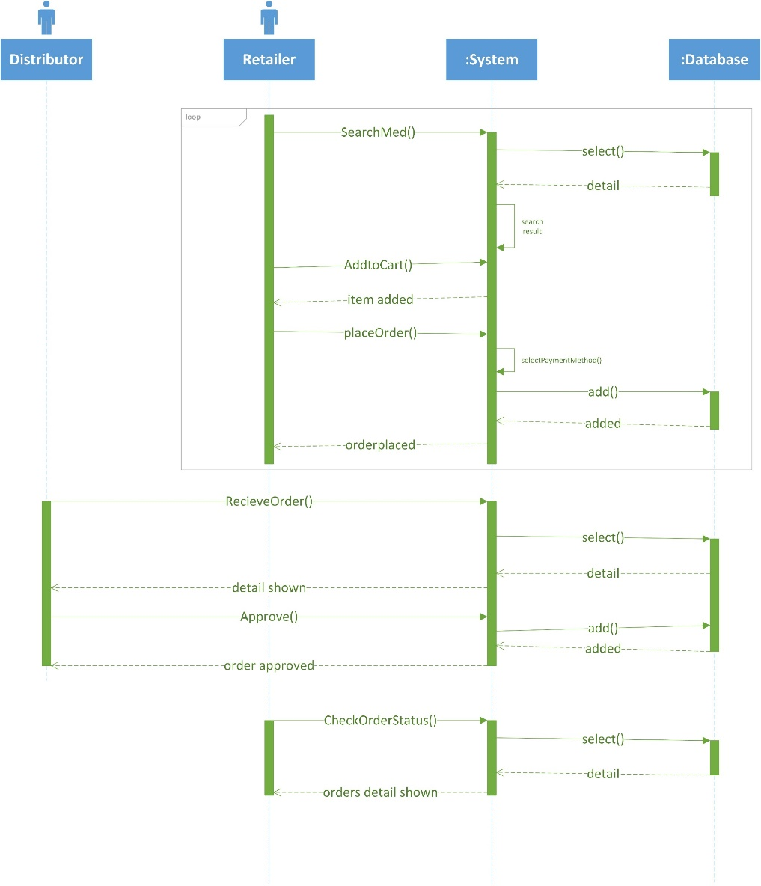
Sequence Diagram
Order Placement
Order Receiving

Slide 17
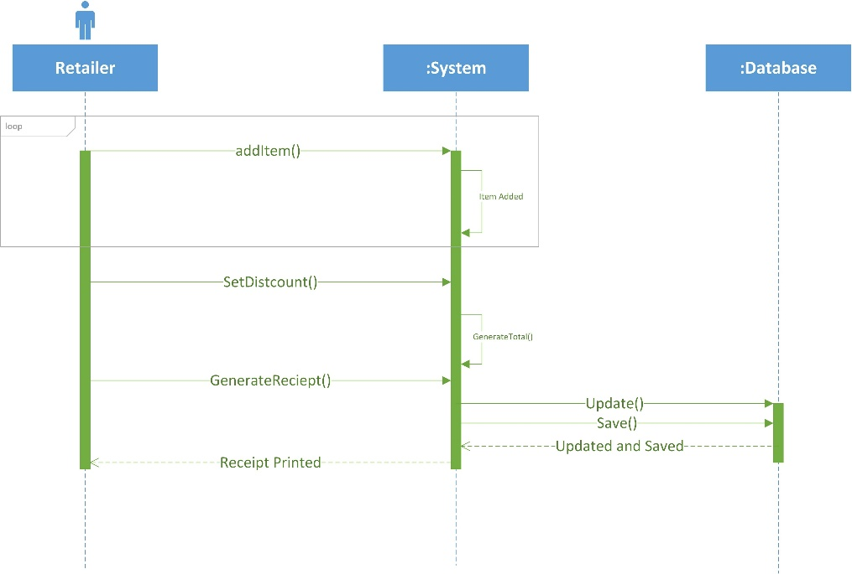
Sequence Diagram
Point of Sale

Slide 18
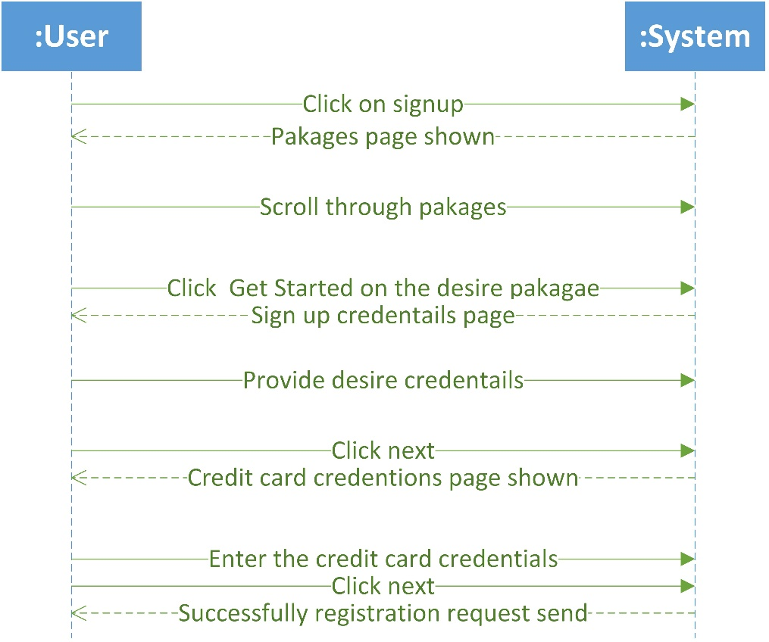
System Sequence Diagram
Sign Up

Slide 19
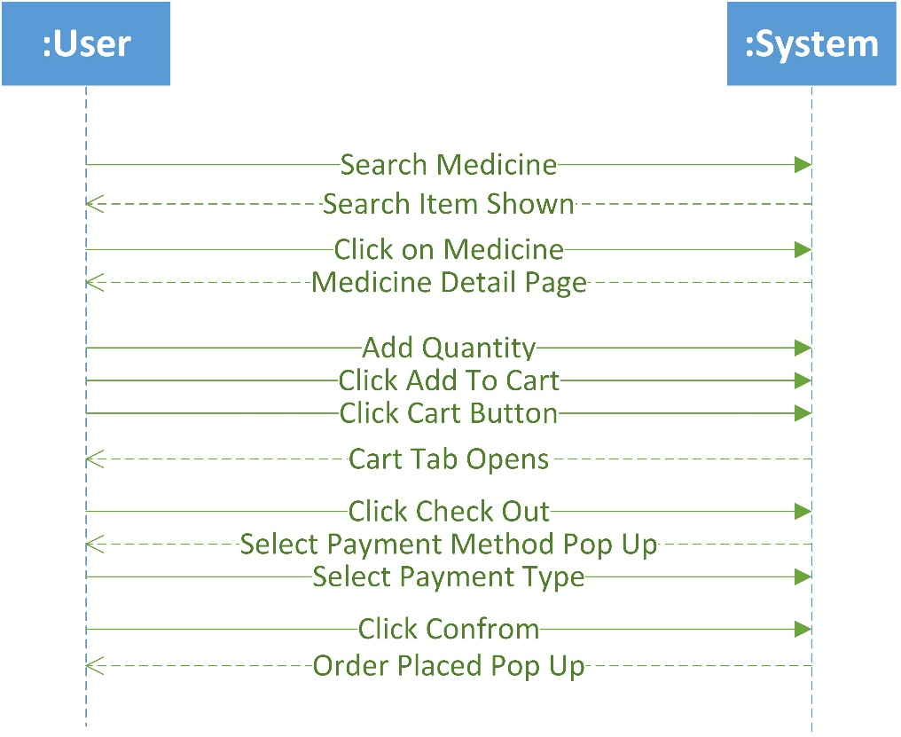
System Sequence Diagram
Online Store

Slide 20
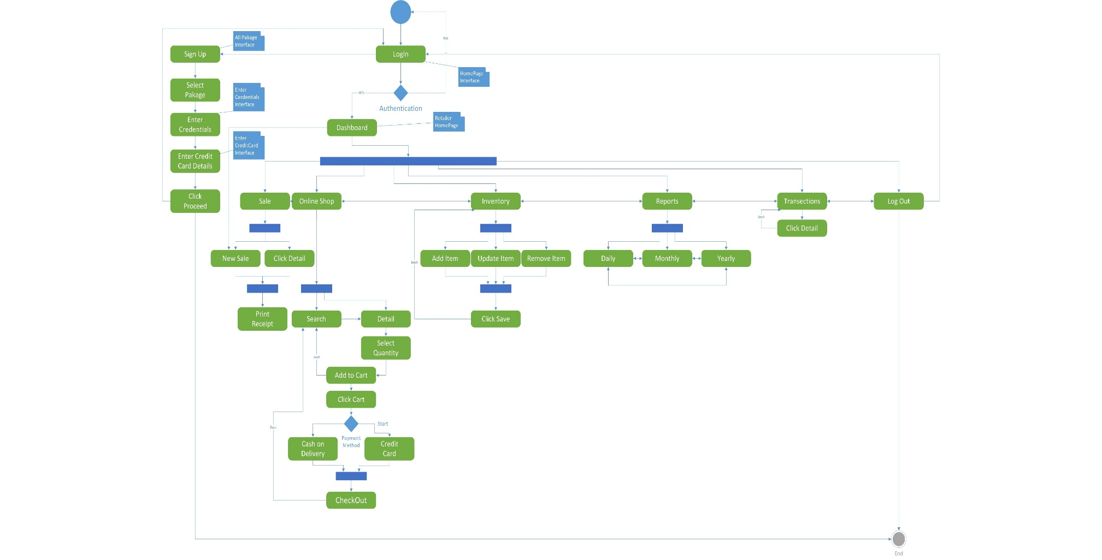
Activity/State Machine Diagram

Slide 21
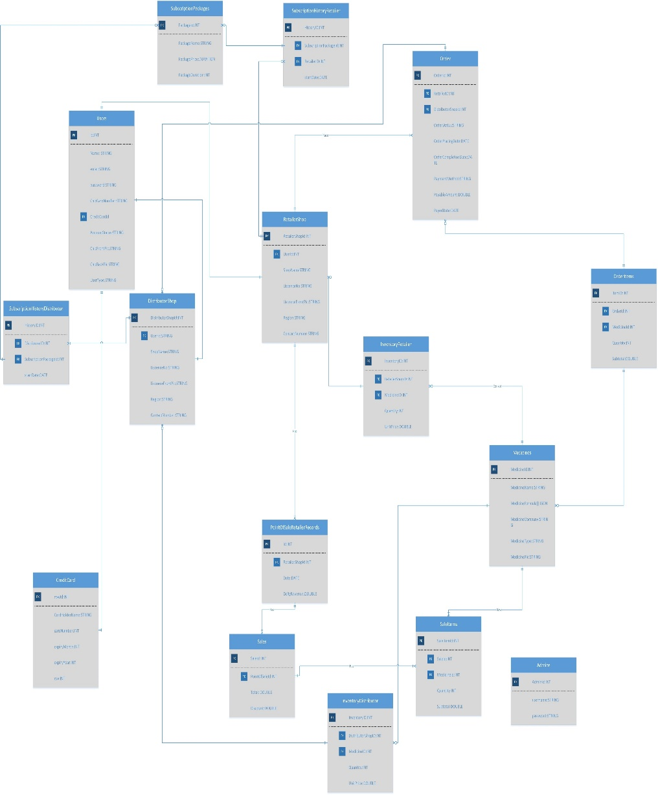
ER Diagram

Slide 22
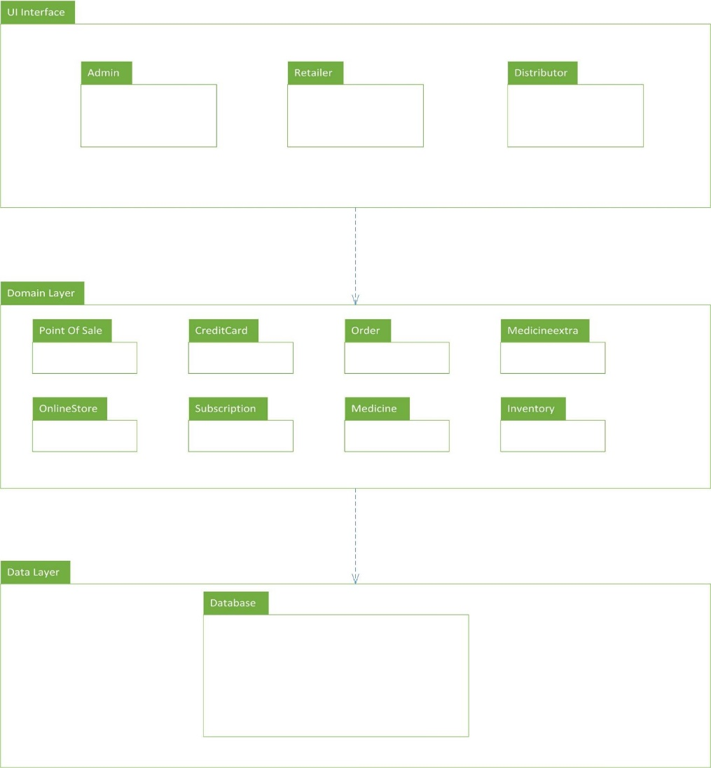
Package Diagram

Slide 23
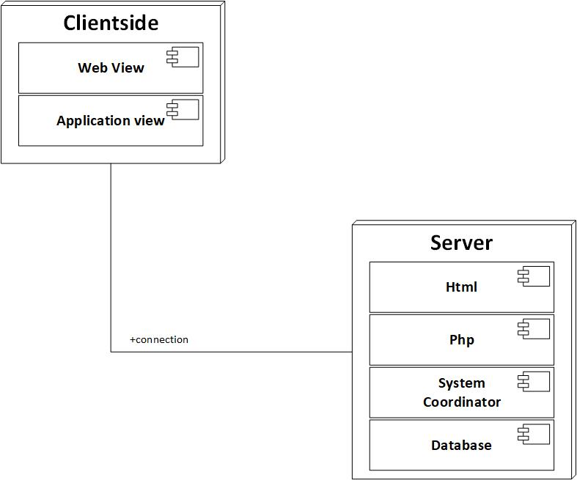
Deployment Diagram

Slide 24
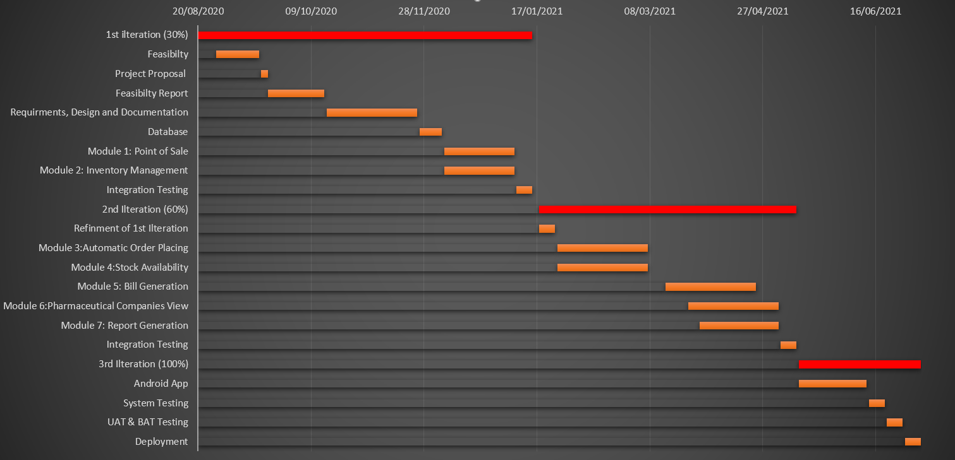
Schedule

Slide 25
Details of 1st Iteration (30%)
SRS
FUNCTIONAL
NON FUCNTIONAL
USER GOAL
SDD
CLASS DIAGRAM
ERD DIAGRAM
USE CASE DIAGRAM
DEATIL USE CASE
SEQUENCE DIAGRAM
SYSTEM SEQUENCE DIAGRAM
PAKAGE DIAGRAM
DEPLOYMENT DIAGRAM
ACTIVUTY DIAGRAM
Database
Online Store

Slide 26
Details of 2nd Iteration (50%)
Point of sale
Inventory Management
Reports Generation

Slide 27
The End

